Slide 1

Common Components
Check this box to force users to type password each time Recommended on shared computers

Slide 2
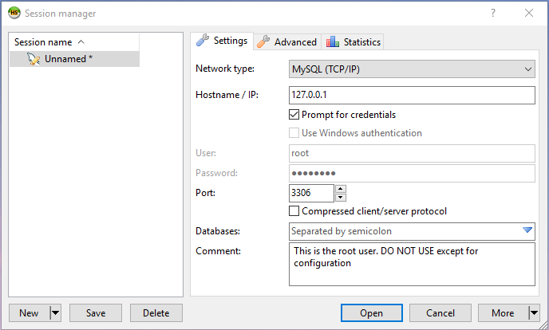
Check this box to force users to type password each time Recommended on shared computers

Slide 3
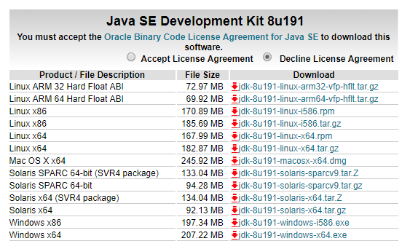
You will need to tick this box also
Windows installers

Slide 4
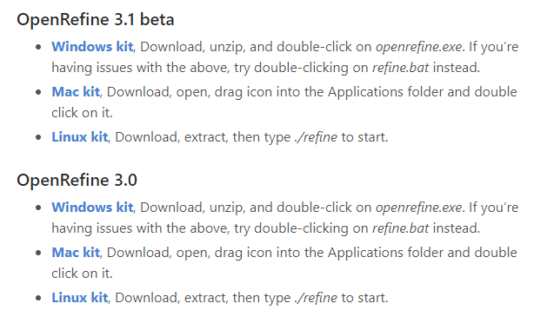
Do not download ‘beta’ versions as they might contain bugs
This version will be better

Slide 5
